Slide 1



Welcome to the Google’s Machine Learning Crash Course!
Women
Techmakers
GDG
Ahmedabad

Slide 2

Hey there, I am Charmi Chokshi!
AI and Data Enthusiast
Final year ICT Engineering Student at Ahmedabad University
Let’s Connect!
LinkedIn
Github
Twitter
Women
Techmakers
GDG
Ahmedabad

Slide 3
Game Time! ☺
Visit kahoot.it
Game Pin: 2125991

Slide 4

Representation
A machine learning model can't directly see, hear, or sense input examples. Instead, you must create a representation of the data to provide the model with a useful vantage point into the data's key qualities.
In traditional programming:
The focus is on code.
In machine learning projects:
The focus shifts to representation.

Slide 5
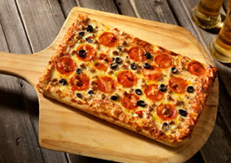
Feature engineering means transforming raw data into a feature vector.
Expect to spend significant time doing feature engineering.
Machine learning models typically expect examples to be represented as numbered vectors.
The vector is constructed by deriving features for each field, then concatenating them all together.
Feature
Engineering
1 0 0 1 1 0 1 1 0 0 0 1
0 0 0 1 1 1

Slide 6
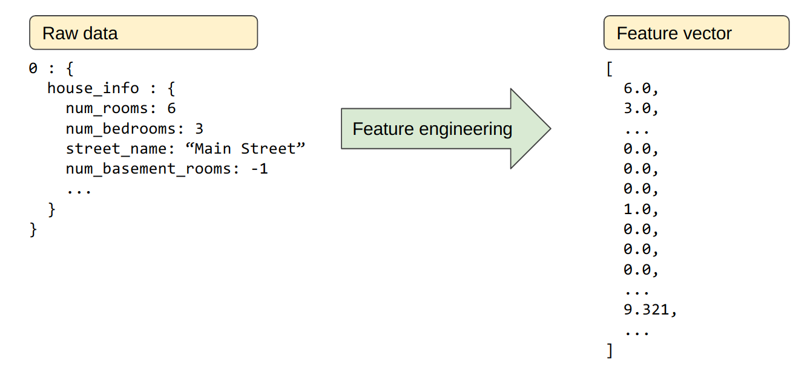
Mapping Raw Data to Features
Figure illustrates raw data from an input data source; the right side illustrates a feature vector, which is the set of floating-point values comprising the examples in your data set.

Slide 7
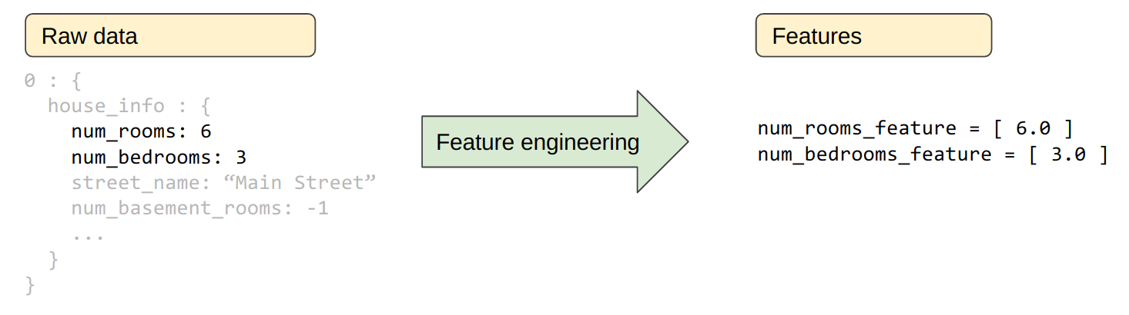
Mapping numeric values
ML models train on floating-point values, so integer and floating-point raw data don't need a special encoding. As suggested in Figure, converting the raw integer value 6 to the feature value 6.0 is trivial.

Slide 8
Mapping string values
Models can't learn from string values, so you'll have to perform some feature engineering to convert those values to something numeric.
One-hot encoding is one popular way to represent string values as a floating-point vector. In a one-hot encoding:
Only one element is set to 1
All other elements are set to 0
Notes:
Which type of matrix is this?
-sparse metrix

Slide 9
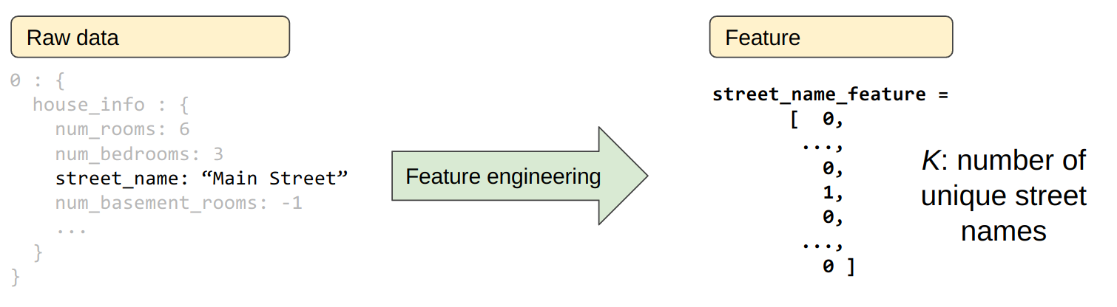
Mapping string values
A one-hot encoding is a sparse vector; that is, a vector that is mostly zeroes. The dimensionality of the vector is the total number of possible values for that field.
For example, the sparse vector representing streets must be large enough to represent all possible street names. The particular street (Main Street in our example) will be stored as a 1, while all other street names will be represented as a 0.

Slide 10
Mapping categorical (enumerated) values
Categorical features have a discrete set of possible values. For example, a feature called `Lowland Countries` would consist of only three possible values:
{'Netherlands', 'Belgium', 'Luxembourg'}
You might be tempted to encode categorical features like `Lowland Countries` as an enumerated type or as a discrete set of integers representing different values. For example:
represent Netherlands as 0
represent Belgium as 1
represent Luxembourg as 2

Slide 11
Mapping categorical (enumerated) values
However, machine learning models typically represent each categorical feature as a separate Boolean value.
For example, `Lowland Countries` would be represented in a model as three separate Boolean features:
x₁: is it Netherlands?
x₂: is it Belgium?
x₃: is it Luxembourg?
Encoding this way also simplifies situations in which a value can belong to more than one category.
For example, "borders France" is True for both Belgium and Luxembourg.

Slide 12
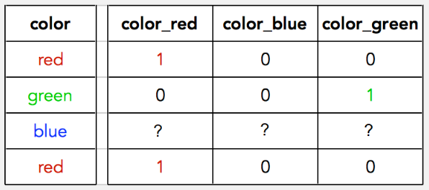
What is the colour code for blue?

Slide 13

Representation: Cleaning Data
Apple trees produce some mixture of great fruit and wormy messes. Yet the apples in high-end grocery stores display 100% perfect fruit. Between orchard and grocery, someone spends significant time removing the bad apples or throwing a little wax on the salvageable ones.

Slide 14

As an ML engineer, you'll spend enormous amounts of your time tossing out bad examples and cleaning up the salvageable ones.
Even a few "bad apples" can spoil a large data set.

Slide 15
Scaling feature values
Scaling means converting floating-point feature values from their natural range into a standard range.
For example, 100 to 900 -> 0 to 1 or -1 to +1
Feature scaling provides the following benefits:
Helps gradient descent converge more quickly
Helps avoid the "NaN trap," in which one number in the model becomes a NaN (e.g., when a value exceeds the floating-point precision limit during training), and—due to math operations—every other number in the model also eventually becomes a NaN.
Helps the model learn appropriate weights for each feature. Without feature scaling, the model will pay too much attention to the features having a wider range.

Slide 16



Slide 17
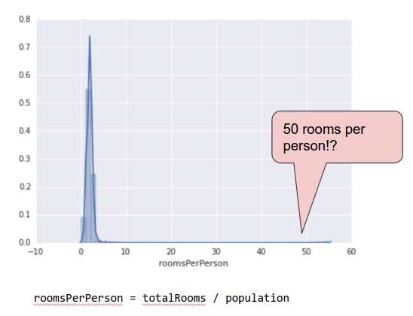
Handling extreme outliers
The following plot represents a feature called roomsPerPerson from the California Housing data set.
The value of roomsPerPerson was calculated by dividing the total number of rooms for an area by the population for that area.
The plot shows that the vast majority of areas in California have one or two rooms per person.

Slide 18
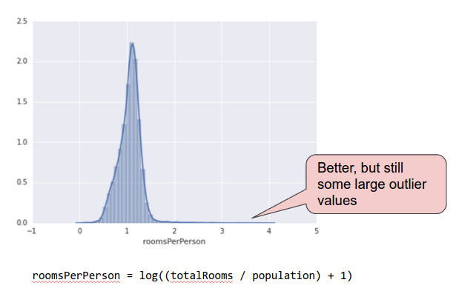
A verrrrry lonnnnnnng tail
Take a look along the x-axis.
How could we minimize the influence of those extreme outliers? Well, one way would be to take the log of every value:
Log scaling does a slightly better job, but there's still a significant tail of outlier values.

Slide 19
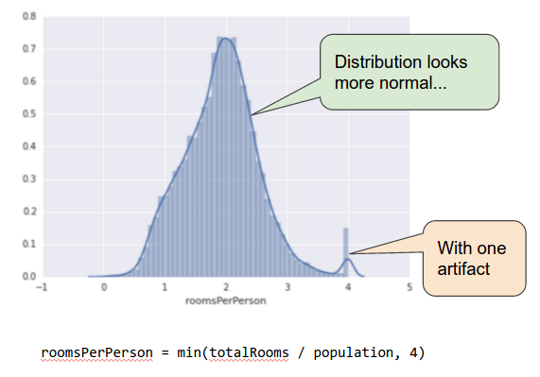
Clipping feature values
Let's pick yet another approach. What if we simply "cap" or "clip" the maximum value of roomsPerPerson at an arbitrary value, say 4.0?
It means that all values that were greater than 4.0 now become 4.0.
This explains the funny hill at 4.0. Despite that hill, the scaled feature set is now more useful than the original data.

Slide 20
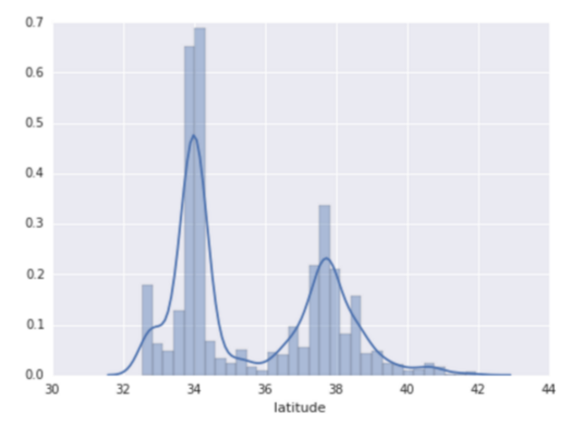
Binning
The following plot shows the relative prevalence of houses at different latitudes in California. Notice the clustering—Los Angeles is at latitude 34 and
San Francisco is roughly at latitude 38.
It doesn't make sense to represent latitude as a floating-point feature in our model.
That's because no linear relationship exists between latitude and housing values.

Slide 21
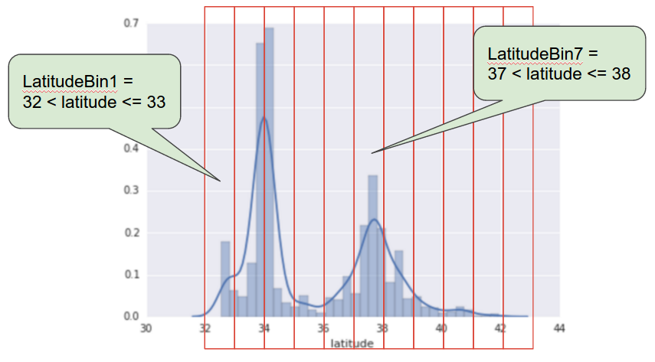
Binning
To make latitude a helpful predictor, let's divide latitudes into "bins" as suggested by the following figure.
Instead of having one floating-point feature, we now have 11 distinct boolean features (LatitudeBin1, LatitudeBin2, ..., LatitudeBin11).
Doing so will enable us to represent latitude 37.4 (San Francisco) as follows:
[0, 0, 0, 0, 0, 1, 0, 0, 0, 0, 0]
Thanks to binning, our
model can now learn
completely different weights
for each latitude.

Slide 22
Scrubbing
Until now, we've assumed that all the data used for training and testing was trustworthy. In real-life, many examples in data sets are unreliable due to one or more of the following:
Omitted values: For instance, a person forgot to enter a value for a house's age.
Duplicate examples: For example, a server mistakenly uploaded the same logs twice.
Bad labels: For instance, a person mislabeled a picture of an oak tree as a maple.
Bad feature values: For example, someone typed in an extra digit, or a thermometer was left out in the sun.
Once detected, you typically "fix" bad examples by removing them from the data set.

Slide 23

Scrubbing
To detect omitted values or duplicated examples, you can write a simple program. Detecting bad feature values or labels can be far trickier.
Histograms are a great mechanism for visualizing your data in the aggregate.
In addition, getting statistics like the following can help:
Maximum and minimum
Mean and median
Standard deviation

Slide 24

Know your data
Follow these rules:
Keep in mind what you think your data should look like.
Verify that the data meets these expectations (or that you can explain why it doesn’t).
Double-check that the training data agrees with other sources (for example, dashboards).
Treat your data with all the care that
you would treat any mission-critical
code.
Good ML relies on good data.

Slide 25
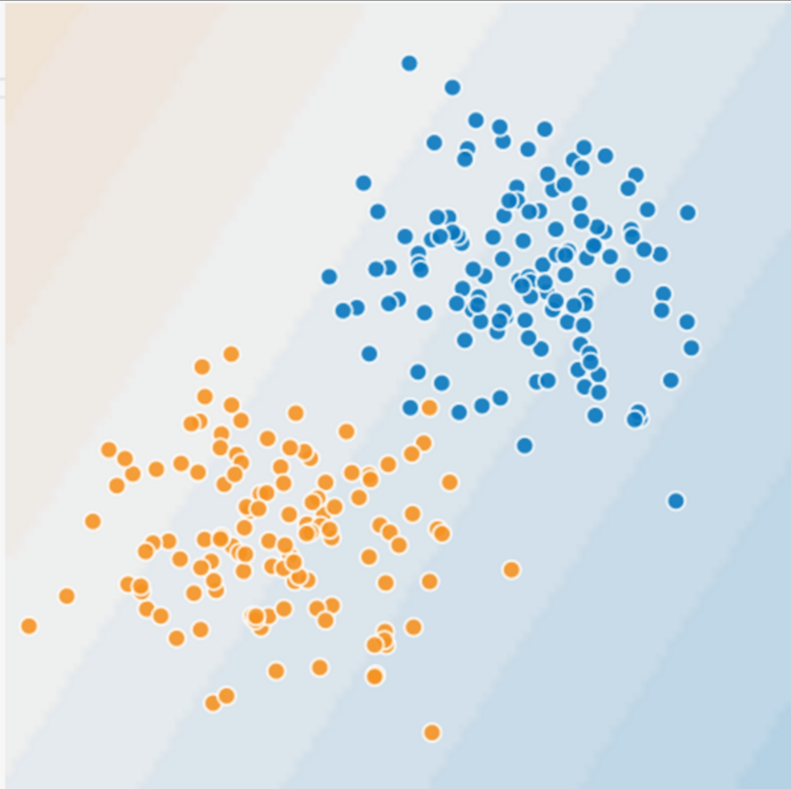
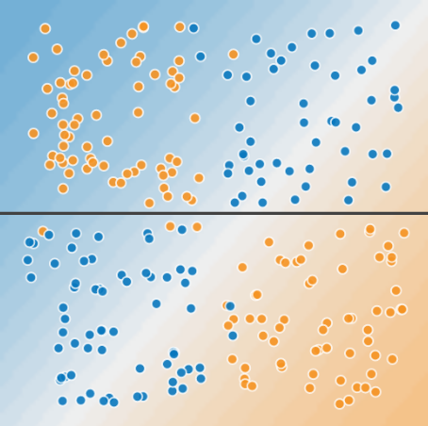
Feature Crosses: Encoding Nonlinearity
The blue dots: sick trees.
The orange dots: healthy trees.
Can you draw a line that neatly separates the sick trees from the healthy trees? Sure.
This is a linear problem.
Can you draw a single straight line that neatly separates trees? No, you can't.
This is a nonlinear problem.

Slide 26
Feature Crosses
A feature cross is a synthetic feature that encodes nonlinearity in the feature space by multiplying two or more input features together.
(The term cross comes from cross product.)
Let's create a feature cross named x3 by crossing x1 and x2:
We treat this newly minted x3 feature cross just like any other feature. The linear formula becomes:
A linear algorithm can learn a weight for w3 just as it would for w1 and w2.
In other words, although w3 encodes nonlinear information, you don’t need to change how the linear model trains to determine the value of w3.

Slide 27
Kinds of feature crosses
We can create many different kinds of feature crosses.
For example:
[A X B]: a feature cross formed by multiplying the values of two features.
[A x B x C x D x E]: a feature cross formed by multiplying the values of five features.
[A x A]: a feature cross formed by squaring a single feature.
Consequently, supplementing scaled linear models with feature crosses has traditionally been an efficient way to train on massive-scale data sets.

Slide 28
Crossing One-Hot Vectors
So far, we've focused on feature-crossing two individual floating-point features. In practice, machine learning models has cross continuous features.
However, machine learning models do frequently cross one-hot feature vectors.
Think of feature crosses of one-hot feature vectors as logical conjunctions.
For example, suppose we have two features: country and language.
A one-hot encoding of each generates vectors with binary features that can be interpreted as
country=USA, country=France or language=English, language=Spanish.
Then, if you do a feature cross of these one-hot encodings, you get binary features that can be interpreted as logical conjunctions, such as:
country:usa AND language:spanish

Slide 29
Crossing One-Hot Vectors
As another example, suppose you bin latitude and longitude, producing separate one-hot five-element feature vectors.
For instance, a given latitude and longitude could be represented as follows:
binned_latitude = [0, 0, 0, 1, 0]
binned_longitude = [0, 1, 0, 0, 0]
Suppose you create a feature cross of these two feature vectors:
binned_latitude X binned_longitude
This feature cross is a 25-element one-hot vector (24 zeroes and 1 one).
The single 1 in the cross identifies a particular conjunction of latitude and longitude.

Slide 30
Crossing One-Hot Vectors
Suppose we bin latitude and longitude much more coarsely, as follows:
binned_latitude(lat) = [ 0 < lat <= 10 10 < lat <= 20 20 < lat <= 30 ]
binned_longitude(lon) = [ 0 < longitude <= 15 15 < longitude <= 30 ]
Creating a feature cross of those coarse bins leads to synthetic feature having the following meanings:
binned_latitude_X_longitude(lat, lon) = [ 0 < lat <= 10 AND 0 < lon <= 15 0 < lat <= 10 AND 15 < lon <= 30 10 < lat <= 20 AND 0 < lon <= 15 10 < lat <= 20 AND 15 < lon <= 30 20 < lat <= 30 AND 0 < lon <= 15 20 < lat <= 30 AND 15 < lon <= 30 ]

Slide 31

Crossing One-Hot Vectors
Now suppose our model needs to predict how satisfied dog owners will be with dogs based on two features:
Behavior type (barking, crying, snuggling, etc.)
Time of day
If we build a feature cross from both these features:
[behavior type X time of day]
For example, if a dog cries (happily) at 5:00 pm when the owner returns from work will likely be a great positive predictor of owner satisfaction.
Crying (miserably, perhaps) at 3:00 am when the owner was sleeping soundly will likely be a strong negative predictor of owner satisfaction.
Linear learners scale well to massive data. Using feature crosses on massive data sets is one efficient strategy for learning highly complex models.

Slide 32


Slide 33
TOPICS FOR INSPIRATION
DAY-TO-DAY LIFE
What solutions, changes and impact can ML make our everyday life better?
MOBILITY
How can ML technologies support customers in their mobility demands?
AGRICULTURE
How can Machine Learning help farmers and create an impact beyond their daily requirements?
HEALTH CARE
How can Machine Learning help doctors solve complex medical issues?
EDUCATION
How can Machine Learning augment schools with better learning experiences?

Slide 34



